Slide 1


Contact-GraspNet : Efficient 6-DoF Grasp Generation in Cluttered Scenes
2021 ICRA
23.11.15 2nd Paper Presentation
20234450 Seokryun Choi
Scalable Graphics, Vision & Robotics Lab
Notes:
Hi today I am going to present ‘Contact-GraspNet : Efficient 6-DoF Grasp Generation in Cluttered Scenes’. This paper was published in ICRA 2021.

Slide 2
Review
Allow an agent to freely switch between MP and direct action execu-tion by controlling the scale of action
Naturally learn trajectories that avoid collisions by leveraging motion plann-ing, while directly executing small actions for sophisticated manipulation
Scalable Graphics, Vision & Robotics Lab
Notes:
Before getting deeper, I’ll briefly review about Motion Planner Augmented Reinforcement Learning for Robot Manipulation in Obstructed Environments which 예은 presented last time. This paper focused on using motion planning to complement DRL. The main idea was to allow an agent to freely switch between MP and direct action execution by controlling the scale of action. By doing this, the agent naturally learns trajectories that avoid collisions by leveraging motion planning, while directly executing small actions for sophisticated manipulation.

Slide 3
Contents
Overview
Background
Method
Result
Conclusion
Quiz
Scalable Graphics, Vision & Robotics Lab
Notes:
Ok let’s move on. These are the contents of today’s presentation.

Slide 4
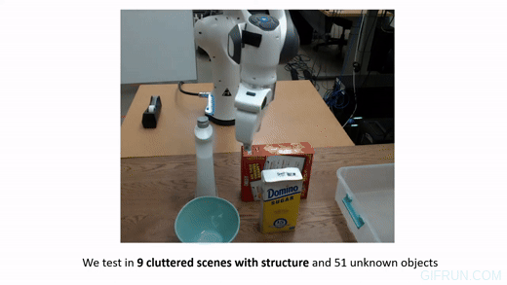
Overview
Task : Grasping unseen objects in un-constrained, cluttered environments
Any collisions must be avoided
Crucial to generate a diverse set of grasps due to kinematic constraints
Scalable Graphics, Vision & Robotics Lab
Notes:
This paper focused on the task of grasping unseen objects in unconstrained, cluttered environments. Unlike other previous works on grasping in clutter, this paper focused on grasping the real-world objects with no planar grasp which is restricted to limited applications. For this task, avoiding any collision and generating a diverse set of grasps is crucial. Depending on the relative pose between the object and the robot, a different subset of grasps is kinematically feasible.

Slide 5
Overview
Proposed a novel end-to-end method for 6-DoF grasping of unknown objects in clutter
Proposed a new grasp pose representation which facilitates learning problem
Robust to the accuracy of a segmentation mask by taking the whole scene
Scalable Graphics, Vision & Robotics Lab
Notes:
To address this task effectively, the authors proposed a novel end to end method that efficiently generates a distribution of 6-DoF parallel-jaw grasps directly from a depth recording of a scene.
Two keypoints of their method are grasp pose representation which facilitates learning problem and the fact that it is robust to the accuracy of a segmentation mask.

Slide 6
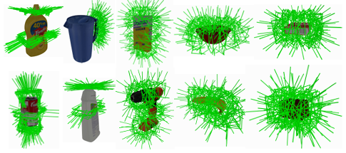
Background
Self-supervised 6d object pose estimation for robot manipulation (ICRA 2020, Deng et al.)
Scalable Graphics, Vision & Robotics Lab
Notes:
Before going into method, let’s go over some background. Grasping has been studied in two main directions, model-based and model-free. As in Self-supervised 6d object pose estimation for robot manipulation, many model based grasping methods circumvent reasoning about the physics of contact and grasp generation by pre-defining a set of grasps in the object frame and transform those grasps according to the 6-DoF object pose. The downside of model-based approaches is that they only work on a limited subset of known objects or categories, and any errors in detecting 6-DoF object pose or object keypoints degrade the grasping performance.

Slide 7
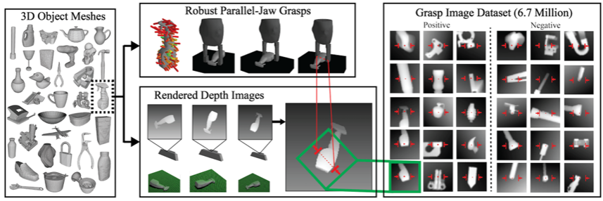
Background
Dex-net 2.0: Deep learning to plan robust grasps with synthetic point clouds and analytic grasp metrics(RSS 2017, Mahler et al.)
Scalable Graphics, Vision & Robotics Lab
Notes:
On the other hand, Model-free approaches do not make any strong assumptions about the category or shape of the object, and they learn a shared representation for all object shapes and sizes. However, having one shared representation for all objects in addition to the large Special Euclidean space for the grasp poses makes the learning problem challenging. As a result, a lot of data-driven grasping methods constrain the space of possible grasps to planar grasping, where grasps are represented by oriented rectangles around each pixel that define the grasp frame. Such a representation needs the camera to view the scene perpendicularly and thus limits 3D reasoning and applications significantly.

Slide 8
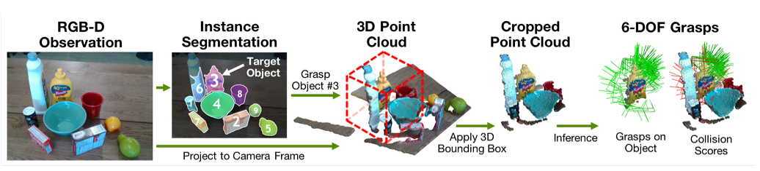
Background
6-dof grasping for target-driven object manipulation in clutter (ICRA 2020, Murali et al.)
Scalable Graphics, Vision & Robotics Lab
Notes:
The proposed method is closely related to the work of Murali et al. 6-dof grasping for target-driven object manipulation in clutter, which was published in ICRA 2020. The goal of this work was to generate collision-free diverse grasps for a designated target object from a partial point cloud of the scene. This work follows a multi-stage process that synthesizes grasps for the target objects from the segmented object point cloud with no context around it, and then filters out the colliding grasps using another learned model.
This leads to 3 issues.
Sensitivity to instance segmentation errors.
Grasps are generated just from the target object point cloud and do not leverage geometric cues in the scene such as table points and surrounding object points.
Grasps are predicted in the large, unconstrained 6-DoF pose space.
To address these issues, the proposed method directly processes a full scene point cloud or a local region around a target object.
Therefore, the quality of the generated grasps is not dependent on an accurate mask and collisions can be directly taken into account during generation.

Slide 9
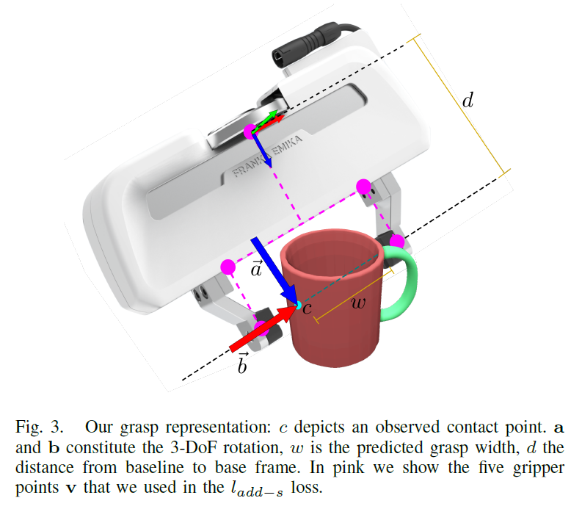

Method
$R_{g} ∈R^{3×3}$ 3-DoF grasp rotation
$w ∈R$ grasp width
$c ∈R^{3}$ contact point
$a ∈R^{3}$ , $\left\|a\right\|=1$ approach vector
$b ∈R^{3}$ , $\left\|b\right\|=1$ baseline vector
$d ∈R^{}$ constant distance from
gripper baseline to the gripper base
Scalable Graphics, Vision & Robotics Lab
Notes:
Let’s look at the method. From a learning perspective, generating the distribution of successful 6-DoF grasps is quite challenging, because the distribution is multi-modal, discontinuous, imbalanced and ambiguous due to (self-) occlusions. Furthermore, direct regression in high dimensional output spaces has been shown to be difficult in grasping. For these reasons the authors came up with an efficient grasp representation.
From the observation, the authors found out that for most predictable two-finger grasps, at least one of the two contacts is visible prior to grasping. Therefore they map a distribution of successful ground truth grasps to their corresponding contact points.
Given that we can predict whether observed points are suitable grasp contacts, we can thus reduce the 6-DoF grasp learning problem to estimating the 3-DoF grasp rotation and grasp width of a parallel-jaw gripper.
This is the proposed grasp representation which reduced 6 DoF into 4 DoF. The reduced dimensionality greatly facilitates the learning process compared to methods that estimate grasp poses in unconstrained SE(3) space.

Slide 10
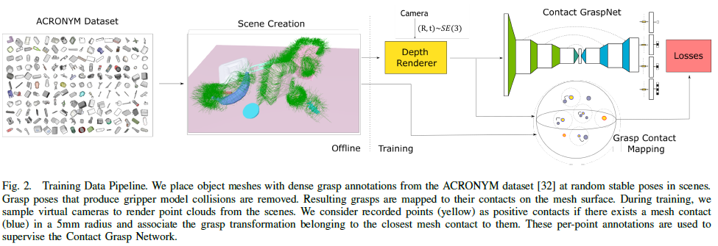
Method
Scalable Graphics, Vision & Robotics Lab
Notes:
This is the training data pipeline. Let’s divide this pipeline in half and look at each part.

Slide 11
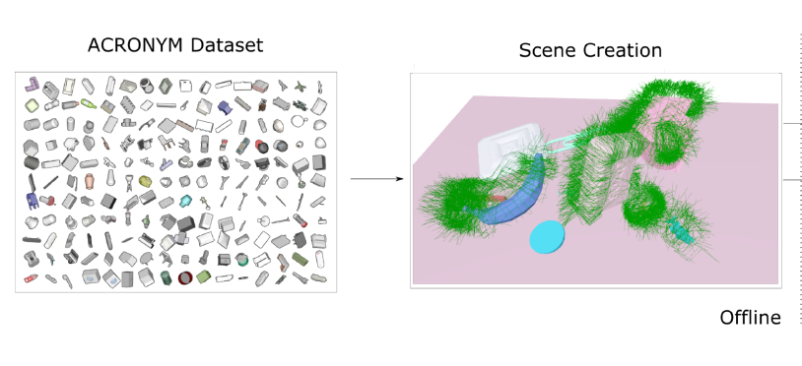
Method
Scalable Graphics, Vision & Robotics Lab
Notes:
In the first part, place object meshes with dense grasp annotations from the ACRONYM dataset at random stable poses in scenes. Grasp poses that produce gripper model collisions are removed.

Slide 12
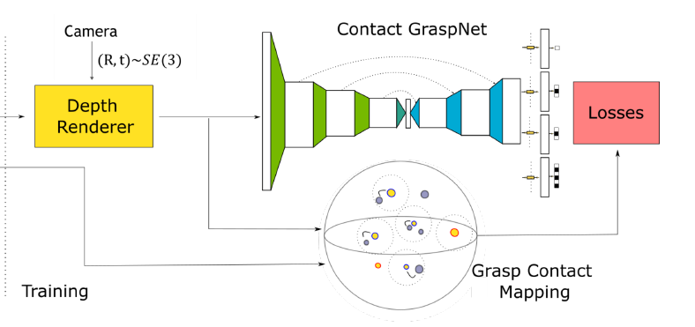
Method
Scalable Graphics, Vision & Robotics Lab
Notes:
In the next part, depth renderer renders point clouds from the depth image. With this point cloud and raw depth image, resulting grasps are mapped on the mesh surface. If there exists a mesh contact(blue) in a 5mm radius, consider recorded points(yellow) as positive contacts and associate the grasp transformation to them. These per-point annotations are used to supervise the Contact Grasp Network. The contact graspnet is built as an asymmetric U-shaped network. The network takes 20000 random points as input and predicts grasps for only 2048 farthest points of the input making sure the predicted grasps have good coverage over the scene. The network has four heads with two 1DConv layers each and per-point outputs contact grasp success predictions, approach vector a, gripper baseline vector b, and grasp width w.
(loss 물어보면 grasp point의 pred와 gt사이 거리 + width Binary Cross Entropy + success prediction BCE)

Slide 13
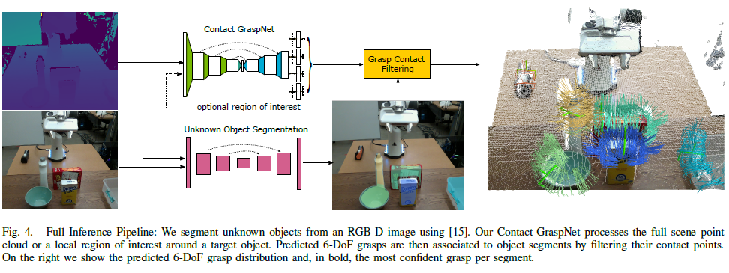
Method
Scalable Graphics, Vision & Robotics Lab
Notes:
In the inference time, the segmentation network segments unknown objects from an RGB-D image and Contact-GraspNet processes the full scene point cloud or a local region of interest around a target object. Predicted 6-DoF grasps are then associated to object segments by filtering their contact points. On the right you can see the predicted 6-DoF grasp distribution and, in bold, the most confident grasp per segment.

Slide 14
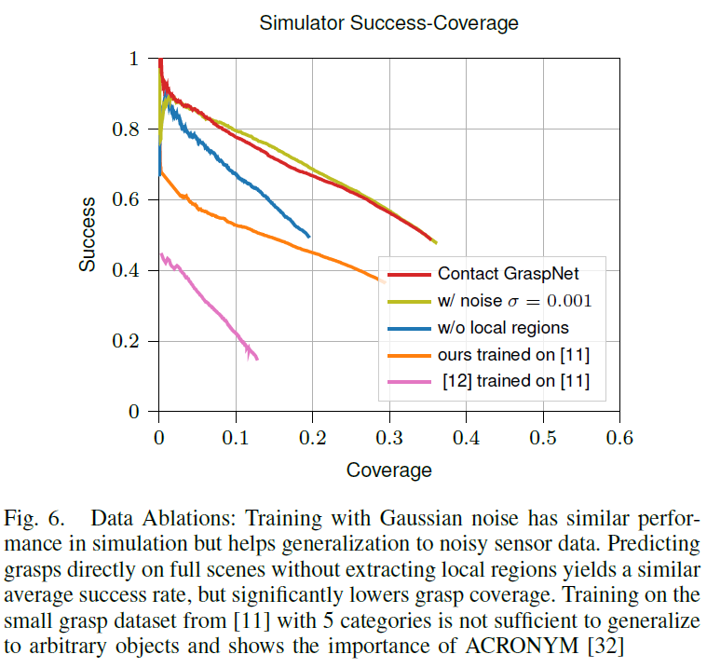
Result
Scalable Graphics, Vision & Robotics Lab
Notes:
This graph shows the results of ablation study. Training with Gaussian noise had similar performance in simulation but helped generalization to noisy sensor data. Predicting grasps directly on full scenes without extracting local regions yielded a similar average success rate, but significantly lowered grasp coverage. Training on the small grasp dataset with 5 categories was not sufficient to generalize to arbitrary objects and showed the importance of ACRONYM.

Slide 15
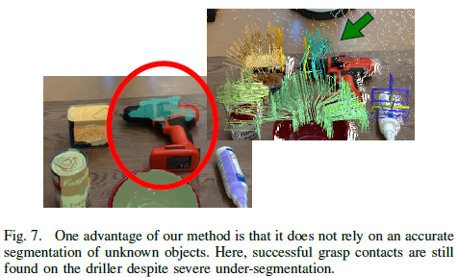
Result
Scalable Graphics, Vision & Robotics Lab
Notes:
Since the proposed method doesn’t rely on an accurate segmentation mask, it is possible to find a successful grasp contacts despite severe under segmentation. One more thing we can see from the figure is that there immensely diverse set of grasps is generated per object.

Slide 16
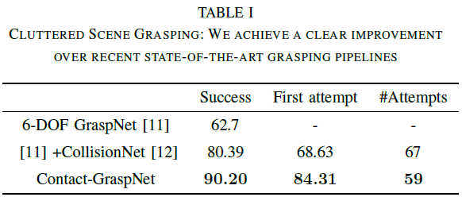
Result
Scalable Graphics, Vision & Robotics Lab
Notes:
The table shows that the success rate increased by 10%. The success rate for the first attempt showed a bigger increase by 16%.
A grasp is considered successful if (1) the open gripper does not collide with the object/scene and (2) the object is still in the gripper after grasping and a shaking motion.
[11]은 이전에 6 DoF grasping연구에서 만들어둔 acronym과 비슷한 데이터인데 카테고리가 훨씬 적음

Slide 17
Conclusion
Greatly limit the predicted pose space and facilitate the learning process
Able to generate diverse grasps and collisions are effectively avoided
Achieved high success rate for grasping with a single attempt
Scalable Graphics, Vision & Robotics Lab
Notes:
In conclusion, this paper greatly limited the predicted pose space and facilitate the learning process.
The proposed method was able to generate diverse grasps while avoiding collisions. Lastly, it achieved a high success rate for grasping, especially for the first attempt.

Slide 18
Quiz
1. The proposed method doesn’t care about collision as long as the robot can grasp the target object successfully. (T / F)
2. With the proposed method, the authors were able to reduce the DoF of representation from 6 to _. What is the appropriate number for the blank?
Scalable Graphics, Vision & Robotics Lab

